Slide 1
C# Collections. Generic collections
By Ira Zavushchak

Slide 2
AGENDA
ArrayList & List<T>,
LinkedList<T>,
Dictionary<T, K>
Lookup<TKey, TElement>
Queue<T>,
Stack<T>,

Slide 3
C# COLLECTIONS
.NET framework provides specialized classes for data storage and retrieval.
There are two distinct collection types in C#:
The standard collections from the System.Collections namespace
The generic collections from System.Collections.Generic
Generic collections are more flexible and safe, and are the preferred way to work with data.

Slide 4
SYSTEM.COLLECTIONS.GENERIC & SYSTEM.COLLECTIONS
System.Collections.Generic System.Collections
List<T> ArrayList
Dictionary<K,T> HashTable
SortedList<K,T>, SortedDictionary<K,T> SortedList
Stack<T> Stack
Queue<T> Queue
LinkedList<T> -
IList<T> IList
IDictionary<K,T> IDictionary
ICollection<T> ICollection
IEnumerator<T> IEnumerator
IEnumerable<T> IEnumerable
IComparer<T> ІComparer
IComparable<T> IComparable

Slide 5
ARRAYLIST & LIST

Slide 6
ARRAYLIST
ArrayList is a special array that provides us with some functionality over and above that of the standard Array.
Unlike arrays, an ArrayList can hold data of multiple data types.
We can dynamically resize it by simply adding and removing elements.
using System.Collections;
class Department
{
ArrayList employees = new ArrayList();
...
}
create ArrayList

Slide 7
ARRAYLIST
public class ArrayList : IList, ICloneable
{
int Add (object value) // at the end
void Insert(int index, object value) ...
void Remove (object value) ...
void RemoveAt(int index) ...
void Clear () ...
bool Contains(object value) ...
int IndexOf (object value) ...
object this[int index] { get... set.. }
int Capacity { get... set... }
void TrimToSize() //minimize memory
...
}
add new elements
remove
containment testing
read/write existing element
control of memory
in underlying array

Slide 8
LIST<T>
List<T> is a strongly typed list of objects that can be accessed by index.
It can be found under System.Collections.Generic namespace
static void Main()
{
List<string> langs = new List<string>();
langs.Add("Java");
langs.Add("C#");
langs.Add("C++");
langs.Add("Javascript");
Console.WriteLine(langs.Contains("C#"));
Console.WriteLine(langs[1]);
langs.Remove("C#");
Console.WriteLine(langs.Contains("C#"));
langs.Insert(2, "Haskell");
langs.Sort();
foreach(string lang in langs)
{ Console.WriteLine(lang); }
}
using System.Collections.Generic;

Slide 9
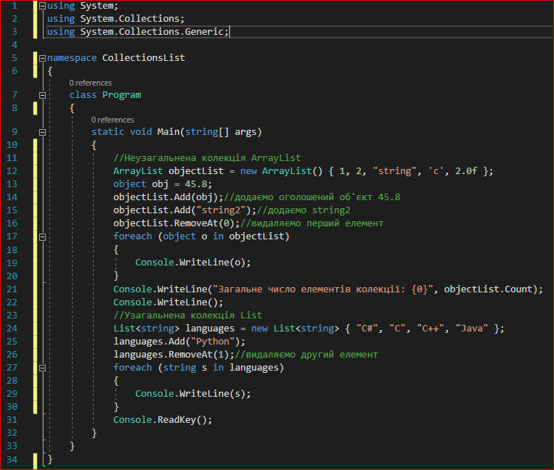
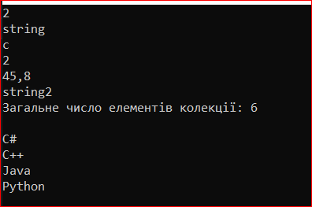
LIST & ARRAYLIST EXAMPLE
Notes:
using System;
using System.Collections;
using System.Collections.Generic;
namespace CollectionsList
{
class Program
{
static void Main(string[] args)
{
//Неузагальнена колекція ArrayList
ArrayList objectList = new ArrayList() { 1, 2, "string", 'c', 2.0f };
object obj = 45.8;
objectList.Add(obj);//додаємо оголошений об'єкт 45.8
objectList.Add("string2");//додаємо string2
objectList.RemoveAt(0);//видаляємо перший елемент
foreach (object o in objectList)
{
Console.WriteLine(o);
}
Console.WriteLine("Загальне число елементiв колекцiї: {0}", objectList.Count);
Console.WriteLine();
//Узагальнена колекція List
List<string> languages = new List<string> { "C#", "C", "C++", "Java" };
languages.Add("Python");
languages.RemoveAt(1);//видаляємо другий елемент
foreach (string s in languages)
{
Console.WriteLine(s);
}
Console.ReadKey();
}
}
}

Slide 10
LINKED LIST<T>

Slide 11
LINKEDLIST<T>
LinkedList<T> represents a doubly linked list in which each element stores a link to the next and previous elements together.
Using the methods of the LinkedList <T> class, you can access various elements, both at the end and at the beginning of the list:
AddAfter (LinkedListNode <T> node, LinkedListNode <T> newNode): inserts the newNode node into the list after the node node.
AddAfter (LinkedListNode <T> node, T value): inserts a new node into the list with the value value after the node node.
AddBefore (LinkedListNode <T> node, LinkedListNode <T> newNode): Inserts a newNode into the list before the node.
AddBefore (LinkedListNode <T> node, T value): inserts a new node into the list with the value value in front of the node node.
AddFirst (LinkedListNode <T> node): inserts a new node at the top of the list
AddFirst (T value): inserts a new node with value value at the top of the list
AddLast (LinkedListNode <T> node): inserts a new node at the end of the list
AddLast (T value): inserts a new node with value value at the end of the list
RemoveFirst (): removes the first node from the list. After this, the new first node becomes the node following the remote
RemoveLast (): removes the last node from the list
Notes:
Клас LinkedList <T> представляє двохзв'язной список, в якому кожен елемент зберігає посилання одночасно на наступний і на попередній елемент.
Якщо в простому списку List <T> кожен елемент являє об'єкт типу T, то в LinkedList <T> кожен вузол являє об'єкт класу LinkedListNode <T>.

Slide 12
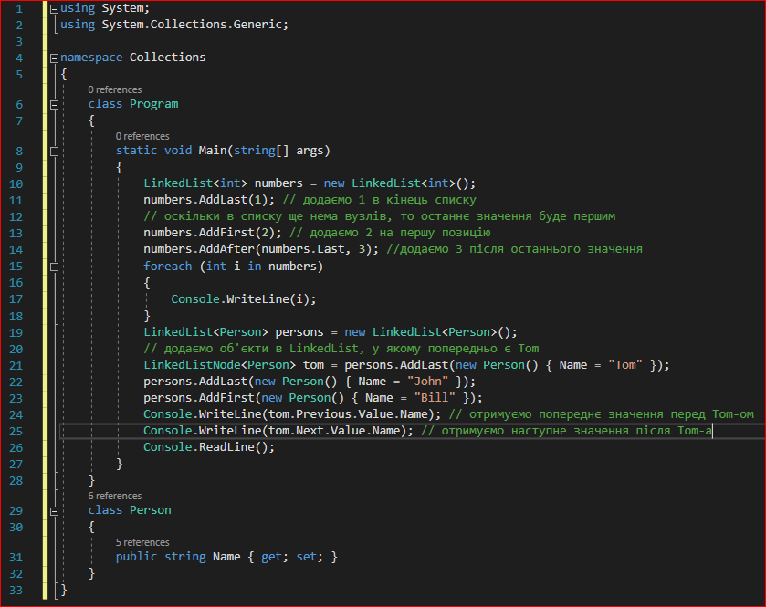
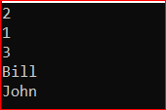
LINKEDLIST<T> EXAMPLE
Notes:
using System;
using System.Collections.Generic;
namespace Collections
{
class Program
{
static void Main(string[] args)
{
LinkedList<int> numbers = new LinkedList<int>();
numbers.AddLast(1); // додаємо 1 в кінець списку
// оскільки в списку ще нема вузлів, то останнє значення буде першим
numbers.AddFirst(2); // додаємо 2 на першу позицію
numbers.AddAfter(numbers.Last, 3); //додаємо 3 після останнього значення
foreach (int i in numbers)
{
Console.WriteLine(i);
}
LinkedList<Person> persons = new LinkedList<Person>();
// додаємо об'єкти в LinkedList, у якому попередньо є Tom
LinkedListNode<Person> tom = persons.AddLast(new Person() { Name = "Tom" });
persons.AddLast(new Person() { Name = "John" });
persons.AddFirst(new Person() { Name = "Bill" });
Console.WriteLine(tom.Previous.Value.Name); // отримуємо попереднє значення перед Tom-ом
Console.WriteLine(tom.Next.Value.Name); // отримуємо наступне значення після Tom-а
Console.ReadLine();
}
}
class Person
{
public string Name { get; set; }
}
}

Slide 13
DICTIONARY<T, K> LOOKUP<TKEY, TELEMENT>

Slide 14

DICTIONARY
A Dictionary, also called an associative array, is a collection of unique keys and a collection of values
Each key is associated with one value.
Retrieving and adding values is very fast.

Slide 15
DICTIONARY
Dictionary where we map domain names to their country names:
Retrieve values by their keys and print the number of items:
Print both keys and values of the dictionary:
Dictionary<string, string> domains = new Dictionary<string, string>();
domains.Add("de", "Germany");
domains.Add("sk", "Slovakia");
domains.Add("us", "United States");
Console.WriteLine(domains["sk"]);
Console.WriteLine(domains["de"]);
Console.WriteLine("Dictionary has {0} items", domains.Count);
foreach(KeyValuePair<string, string> kvp in domains)
{
Console.WriteLine("Key = {0}, Value = {1}", kvp.Key, kvp.Value);
}

Slide 16
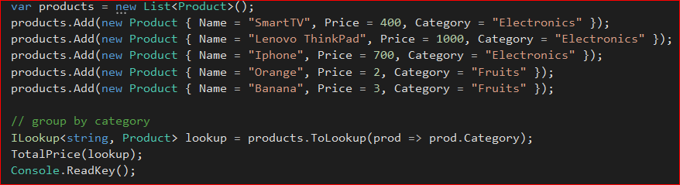
LOOKUP<TKEY, TELEMENT>
Lookup <TKey, TElement> is similar to Dictionary <TKey, Collection <TElement>> - this is a list of zero or more elements can be returned using the same key.
It allows you to group items together using a key, but then use them effectively with that key (and not just iterate over everything that GroupBy allows).
Notes:
Lookup <TKey, TElement> нагадує Dictionary <TKey, TValue>. Різниця полягає в тому, що Dictionary <TKey, TValue> зіставляє ключі з поодинокими значеннями, в той час як Lookup <TKey, TElement> зіставляє ключі з колекціями значень.

Slide 17
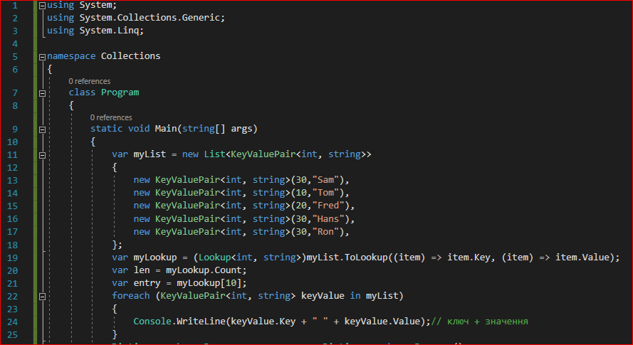
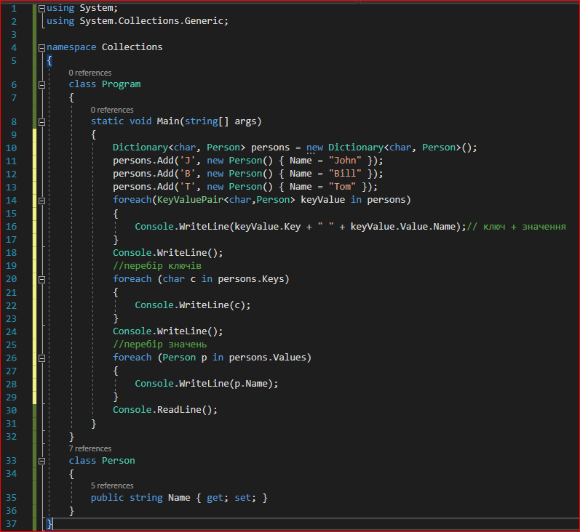
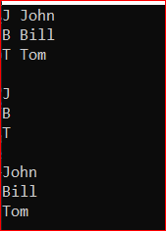
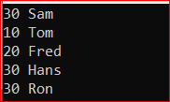
DICTIONARY & LOOKUP EXAMPLE
Notes:
using System;
using System.Collections.Generic;
namespace Collections
{
class Program
{
static void Main(string[] args)
{
var myList = new List<KeyValuePair<int, string>>
{
new KeyValuePair<int, string>(30,"Sam"),
new KeyValuePair<int, string>(10,"Tom"),
new KeyValuePair<int, string>(20,"Fred"),
new KeyValuePair<int, string>(30,"Hans"),
new KeyValuePair<int, string>(30,"Ron"),
};
var myLookup = (Lookup<int, string>)myList.ToLookup((item) => item.Key, (item) => item.Value);
var len = myLookup.Count;
var entry = myLookup[10];
foreach (KeyValuePair<int, string> keyValue in myList)
{
Console.WriteLine(keyValue.Key + " " + keyValue.Value);// ключ + значення
}
Dictionary<char, Person> persons = new Dictionary<char, Person>();
persons.Add('J', new Person() { Name = "John" });
persons.Add('B', new Person() { Name = "Bill" });
persons.Add('T', new Person() { Name = "Tom" });
foreach(KeyValuePair<char,Person> keyValue in persons)
{
Console.WriteLine(keyValue.Key + " " + keyValue.Value.Name);// ключ + значення
}
Console.WriteLine();
//перебір ключів
foreach (char с in persons.Keys)
{
Console.WriteLine(с);
}
Console.WriteLine();
//перебір значень
foreach (Person p in persons.Values)
{
Console.WriteLine(p.Name);
}
Console.ReadLine();
}
}
class Person
{
public string Name { get; set; }
}
}

Slide 18
QUEUE<T> & STACK<T>

Slide 19
QUEUE
A Queue is a First-In-First-Out (FIFO) data structure.
The first element added to the queue will be the first one to be removed.
Queues may be used to process messages as they appear or serve customers as they come.
Methods:
Clear(); removes all elements from the Queue.
Contains(object obj); determines whether an element is in the Queue.
Dequeue(); removes and returns the object at the beginning of the Queue.
Enqueue(object obj); adds an object to the end of the Queue.
ToArray(); Copies the Queue to a new array.

Slide 20
STACK
A stack is a Last-In-First-Out (LIFO) data structure.
The last element added to the queue will be the first one to be removed.
The C language uses a stack to store local data in a function. The stack is also used when implementing calculators.
Stack<int> stc = new Stack<int>();
stc.Push(1);
stc.Push(4);
stc.Push(3);
stc.Push(6);
Console.WriteLine(stc.Pop());
Console.WriteLine(stc.Peek());
Console.WriteLine(stc.Peek());
Console.WriteLine();
foreach(int item in stc)
{
Console.WriteLine(item);
}

Slide 21
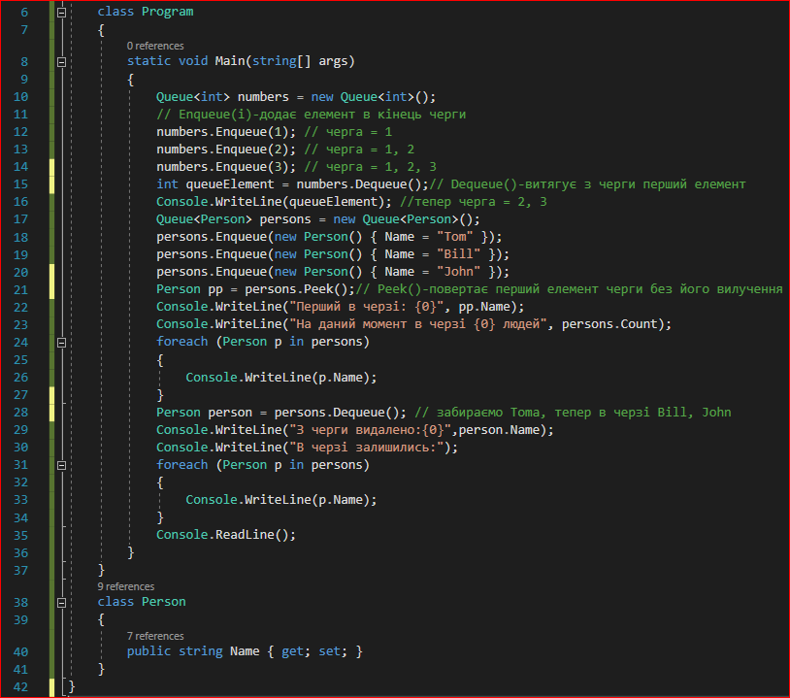
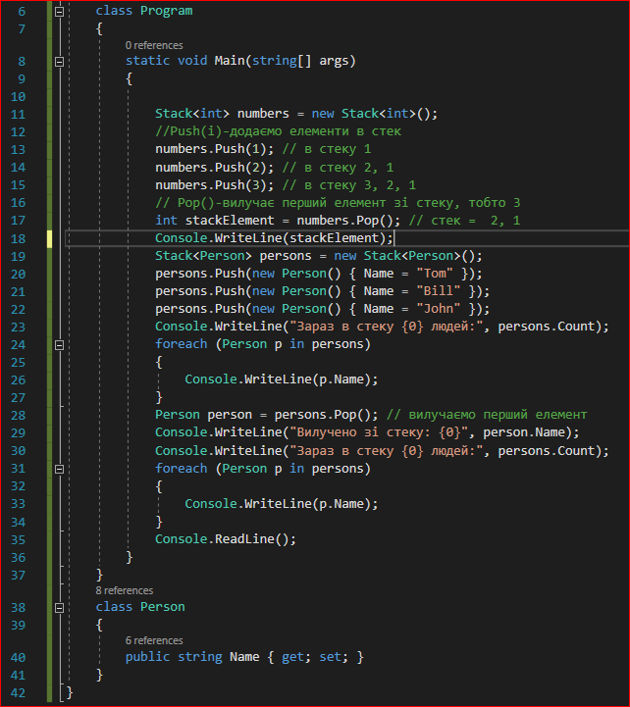
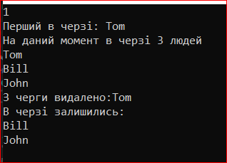
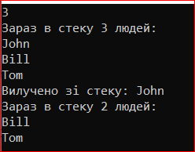
QUEUE & STACK EXAMPLE
Notes:
using System;
using System.Collections.Generic;
namespace Collections
{
class Program
{
static void Main(string[] args)
{
Queue<int> numbers = new Queue<int>();
// Enqueue(і)-додає елемент в кінець черги
numbers.Enqueue(1); // черга = 1
numbers.Enqueue(2); // черга = 1, 2
numbers.Enqueue(3); // черга = 1, 2, 3
int queueElement = numbers.Dequeue();// Dequeue()-витягує з черги перший елемент
Console.WriteLine(queueElement); //тепер черга = 2, 3
Queue<Person> persons = new Queue<Person>();
persons.Enqueue(new Person() { Name = "Tom" });
persons.Enqueue(new Person() { Name = "Bill" });
persons.Enqueue(new Person() { Name = "John" });
Person pp = persons.Peek();// Peek()-повертає перший елемент черги без його вилучення
Console.WriteLine("Перший в черзi: {0}", pp.Name);
Console.WriteLine("На даний момент в черзi {0} людей", persons.Count);
foreach (Person p in persons)
{
Console.WriteLine(p.Name);
}
Person person = persons.Dequeue(); // забираємо Toma, тепер в черзі Bill, John
Console.WriteLine("З черги видалено:{0}",person.Name);
Console.WriteLine("В черзi залишились:");
foreach (Person p in persons)
{
Console.WriteLine(p.Name);
}
Console.ReadLine();
}
}
class Person
{
public string Name { get; set; }
}
}
_____________________________________________________________
using System;
using System.Collections.Generic;
namespace Collections
{
class Program
{
static void Main(string[] args)
{
Stack<int> numbers = new Stack<int>();
//Push(і)-додаємо елементи в стек
numbers.Push(1); // в стеку 1
numbers.Push(2); // в стеку 2, 1
numbers.Push(3); // в стеку 3, 2, 1
// Pop()-вилучає перший елемент зі стеку, тобто 3
int stackElement = numbers.Pop(); // стек = 2, 1
Console.WriteLine(stackElement);
Stack<Person> persons = new Stack<Person>();
persons.Push(new Person() { Name = "Tom" });
persons.Push(new Person() { Name = "Bill" });
persons.Push(new Person() { Name = "John" });
Console.WriteLine("Зараз в стеку {0} людей:", persons.Count);
foreach (Person p in persons)
{
Console.WriteLine(p.Name);
}
Person person = persons.Pop(); // вилучаємо перший елемент
Console.WriteLine("Вилучено зi стеку: {0}", person.Name);
Console.WriteLine("Зараз в стеку {0} людей:", persons.Count);
foreach (Person p in persons)
{
Console.WriteLine(p.Name);
}
Console.ReadLine();
}
}
class Person
{
public string Name { get; set; }
}
}

Slide 22
Useful links
https://metanit.com/sharp/tutorial/4.3.php
https://docs.microsoft.com/ru-ru/dotnet/api/system.collections?view=netcore-3.1
https://professorweb.ru/my/csharp/charp_theory/level12/12_1.php
https://www.tutorialspoint.com/csharp/csharp_collections.htm
https://www.tutorialsteacher.com/csharp/csharp-collection

Slide 23


